Slide 1
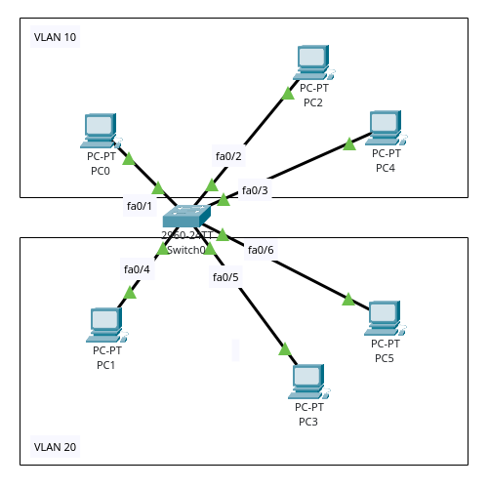
VLAN Configuration
Md. Sharafat Karim
ID 2102024

Slide 2
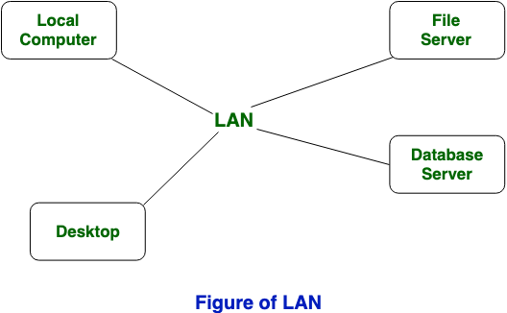
LAN
A LAN, or Local Area Network, is a group of computers and devices connected in a small area, like an office or home. These devices can talk to each other and share things like files and printers.

Slide 3
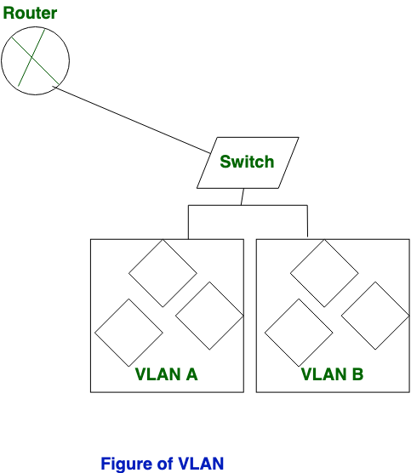
VLAN
A VLAN, or Virtual Local Area Network, is a way to split one big network into smaller parts. It's like creating separate groups within a single network.

Slide 4
Basic VLAN Configuration

Slide 5
Objectives
Create isolated broadcast domains (VLANs) on a single physical switch.
Sales (VLAN 10)
PCs 1, 2, and 3 connected to FastEthernet 0/1 - 0/3.
Accounts (VLAN 20)
PCs 4, 5, and 6 connected to FastEthernet 0/4 - 0/6.
Verification
Pings within the same VLAN should succeed. Pings across different VLANs will fail without a Layer 3 device

Slide 6
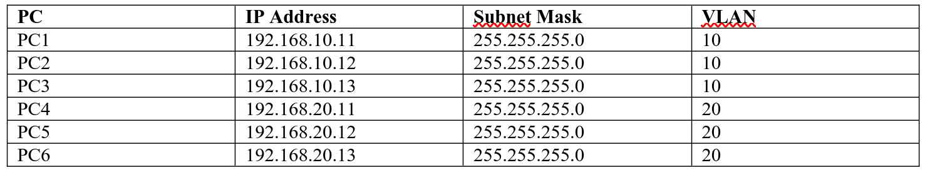
IP Addressing
1 × Cisco 2960 Switch
6 × PCs
3 PCs for VLAN 10 – Sales
3 PCs for VLAN 20 – Accounts

Slide 7
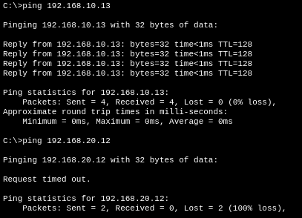
VLAN
From PC0

Slide 8
Inter VLAN Routing

Slide 9
Objectives
Allow VLAN 10 and VLAN 20 to communicate through a router.
Employs a single physical router interface to route traffic between multiple VLANs.
Trunk Link
The switch port connected to the router is configured as a trunk to carry all VLAN traffic.
Subinterfaces
Virtual interfaces on the router, each assigned to handle a specific VLAN's gateway.

Slide 10
IP Addressing
1 × Cisco 2960 Switch
6 × PCs
3 PCs for VLAN 10 – Sales
3 PCs for VLAN 20 – Accounts
1 × Cisco 2911 Router

Slide 11
IP Addressing
Router subinterfaces
G0/0.10 = 192.168.10.1
G0/0.20 = 192.168.20.1.

Slide 12
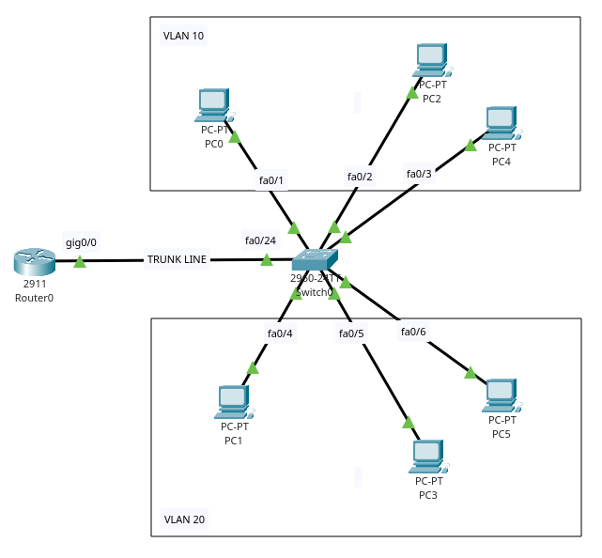
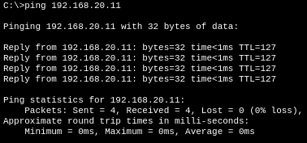
Inter VLAN Routing
From PC0

Slide 13
VLAN with DHCP

Slide 14
Objectives
Automate IP address assignment for PCs using the Cisco Router as a DHCP server.
DHCP Pools
Dedicated IP address ranges are created for
  SALES (VLAN 10)
  ACCOUNTS (VLAN 20).
Excluded Addresses
Gateways (192.168.10.1, .20.1) are excluded to prevent IP conflicts.
Verification
Client PCs automatically obtain an IP, Subnet Mask, Default Gateway, and DNS server.

Slide 15
Requirements
1 × Cisco 2960 Switch
6 × PCs
3 PCs for VLAN 10 – Sales
3 PCs for VLAN 20 – Accounts
1 × Cisco 2911 Router

Slide 16
IP Addressing
Router subinterfaces
G0/0.10 = 192.168.10.1
G0/0.20 = 192.168.20.1.

Slide 17
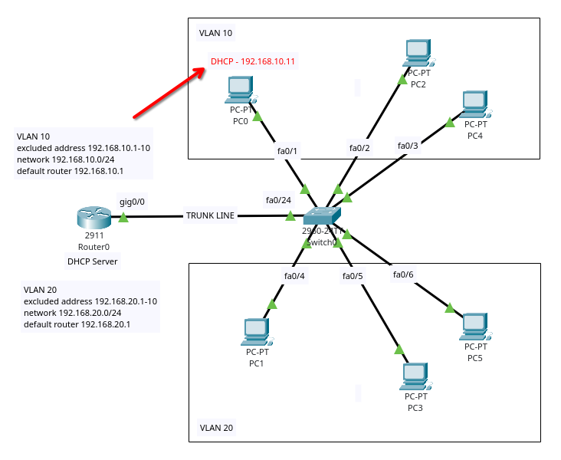
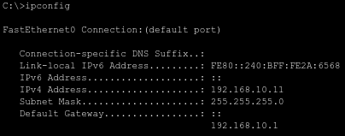
VLAN with DHCP
PC0

